Slide 1

Team Beanstalk – Premiere Project Presentation
24 JUNE 2023

Slide 2


Our Team
Other Team Members
Role: / Name: Yohanes Teshome Kebede | Role / Name: Oreoluwa
Role: / Name: Joshua Peter | Role / Name:
Role: / Name: Yvvon Jemmy | Role / Name:
Role: / Name: Kandasamy K | Role / Name:
Role: / Name: Kolade Datun | Role / Name:
Role: / Name: Fatunbi Abiodun | Role / Name:
Role / Name: Jerry Esorh | Role / Name:
Role / Name: Dhotman | Role / Name:
Sonibare Mujeeb
Kandasamy K
Role: Presenter 1
Role: Presenter 2
Project Lead
Sonibare Mujeeb
Assistant Project Lead
Calista Uchenna Dikeh
Query Analyst
Ihuoma Clara Aduba

Slide 3
Problem Statement
We are to predict the total number of daily demand orders for a Brazilian logistic company
We should build a statistical/machine learning model that can accurately predict the total number of orders on a daily basis

Slide 4
Our approach
Exploratory Data Analysis (EDA) of the Dataset.
Data Manipulation & Pre-processing.
Model Fitting on the given dataset.
Evaluation of the best-fit models.

Slide 5
Dataset description
The given dataset is a CSV file.
Imported the dataset through the pd.read_csv function.
We started with installing and importing libraries required for the project, as given below
-Data Manipulation Libraries – Pandas and Numpy.
-Data Visualization Libraries – Seaborn, matplotlib.pyplot, plotly.express.
This is a real database of a brazilian logistics company collected for 60 days. The dataset has twelve predictive attributes and a target variable that is the total of orders for daily treatment. The dataset input features are “Week_of_the_month”, “Day_of_the_week_(Monday_to_Friday)”,”Non_urgent_order ” Urgent_order “Order_type_A” “Order_type_B” ,”Order_type_C” , “Fiscal_sector_orders ”, “Orders_from_the_traffic_controller”,”Banking_orders_(1)” ,”Banking_orders_(2)” and “Banking_orders_(3)”. All variables are numerical variables.
The dataset was downloaded from this online repository https://archive.ics.uci.edu/datasets?search=Daily%20Demand%20Forecasting%20Orders

Slide 6
Dataset description
Exploratory Data Analysis (EDA) was done as explained below.
The Dataset has 60 rows and 13 columns.
The dataset was checked for the presence of any missing values – there were no missing values.
The dataset was checked for the presence of any duplicate values – there were no duplicate values.
The basic statistics of the dataset were checked – mean, standard deviation, min, and max values of each column were checked

Slide 7
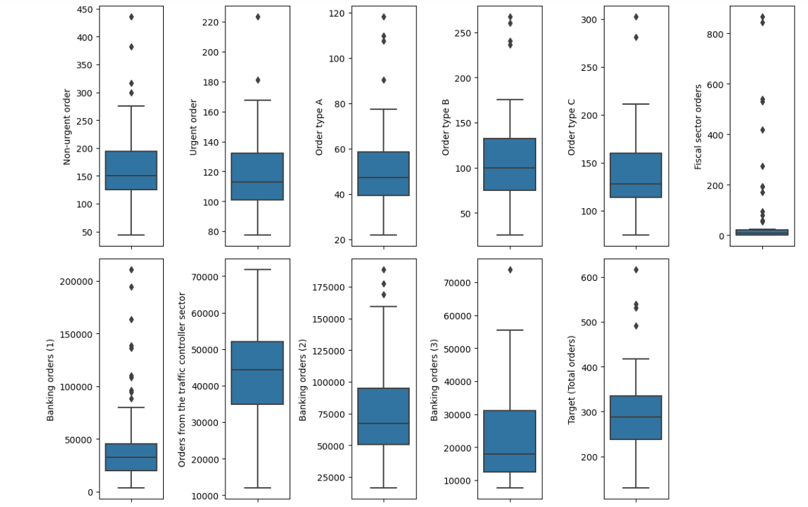
Dataset description
The presence of outliers in the dataset was checked using boxplots – the columns fiscal sector orders, and Banking order (3) had outlier values.

Slide 8
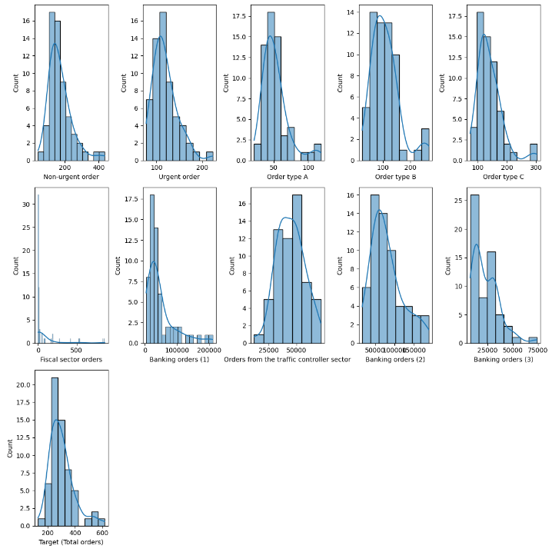
Dataset description
Skewness of the given dataset is checked and found as most of the data points are positively skewed as data columns are within the acceptable range.
The distribution of the dataset columns was checked using a histogram and can be seen most data are skewed to the right with more bar on the right side of the mean, however, they are all almost normally distributed.

Slide 9
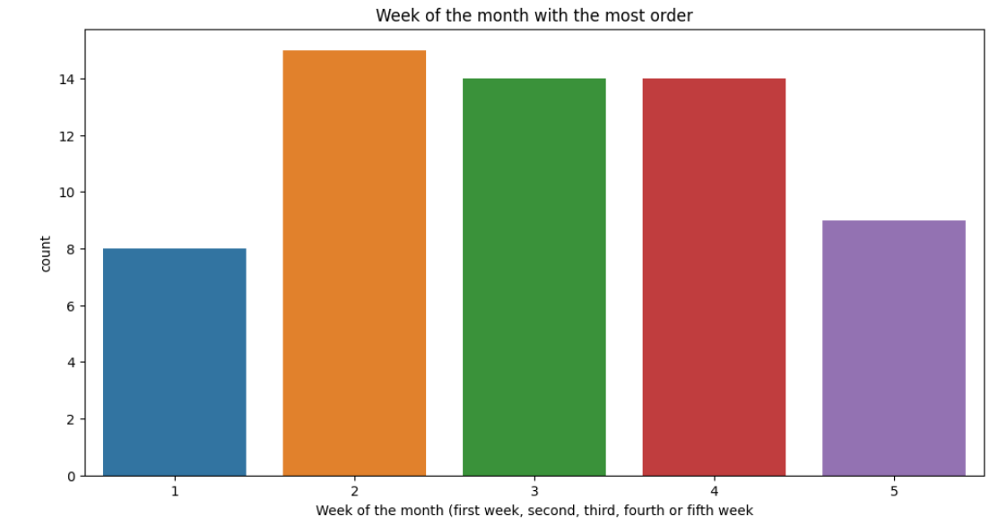
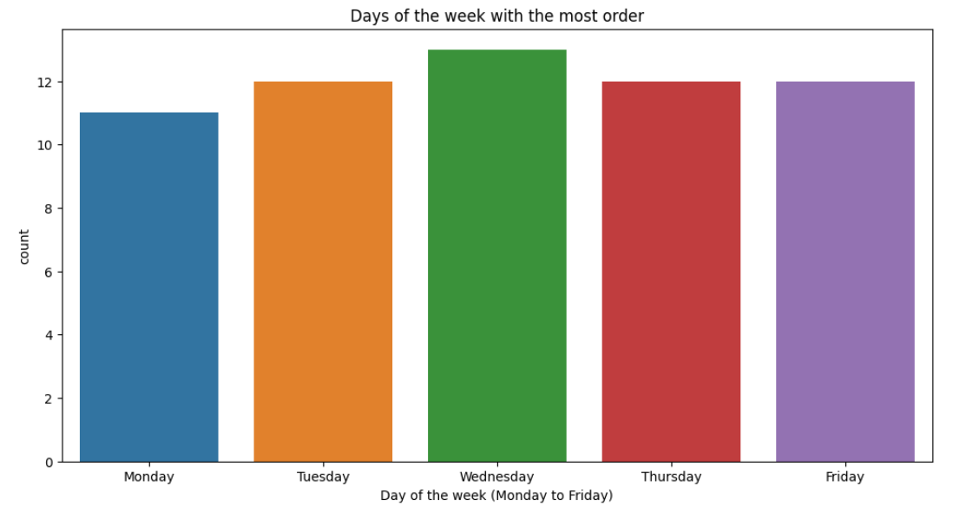
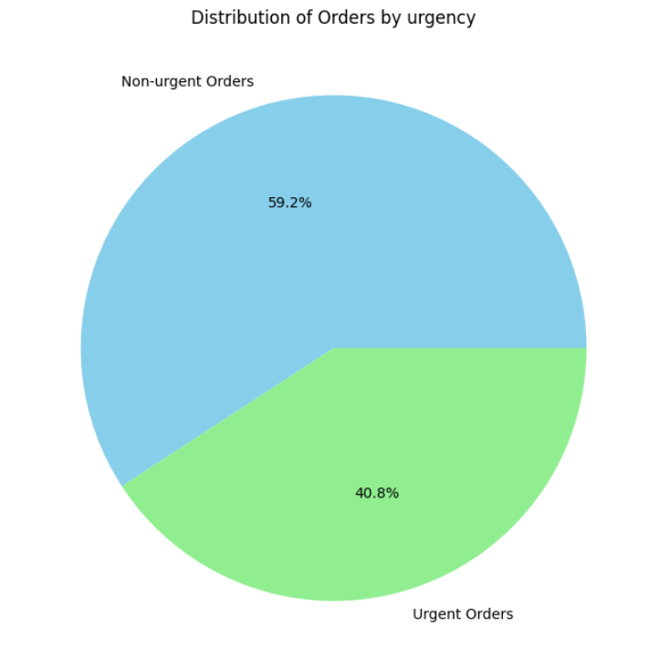
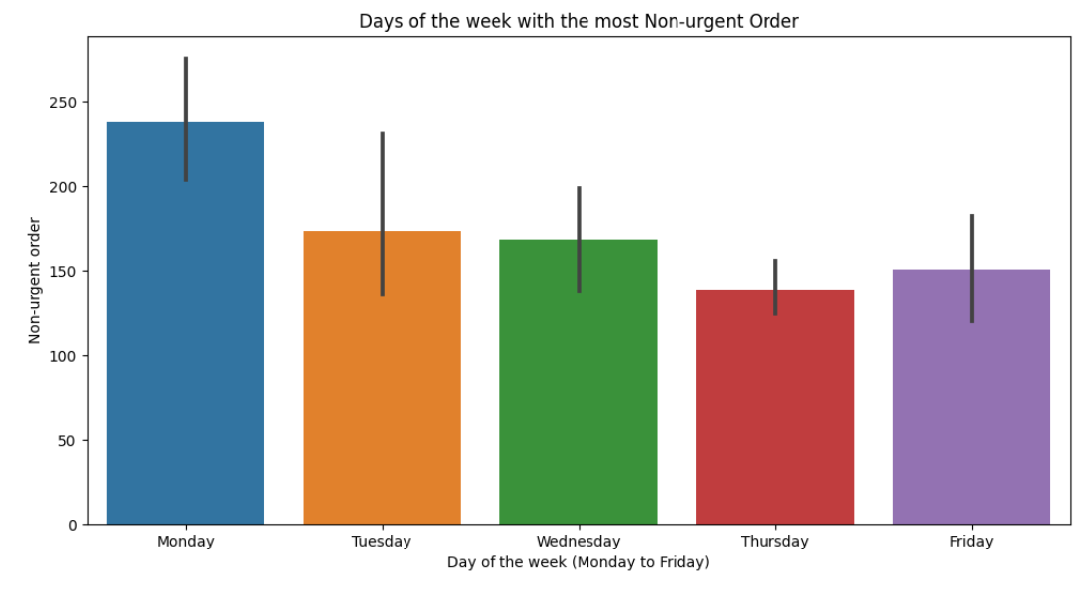
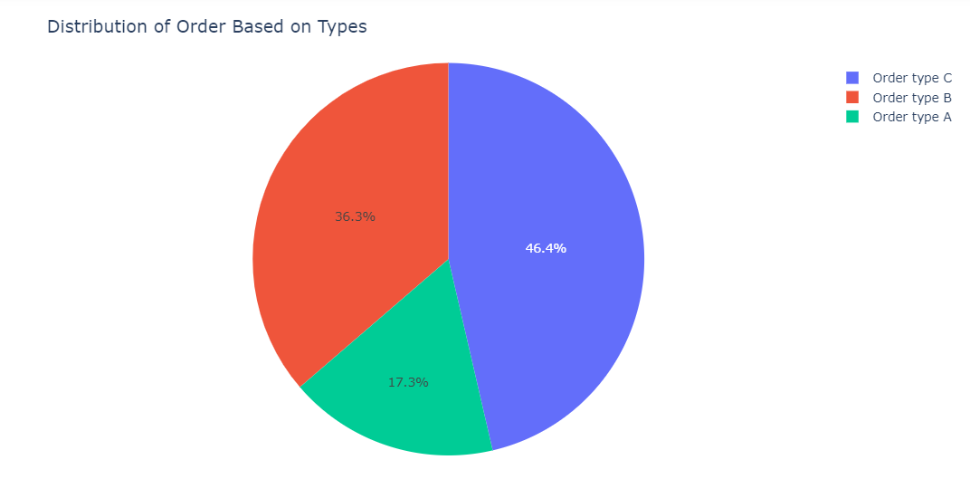
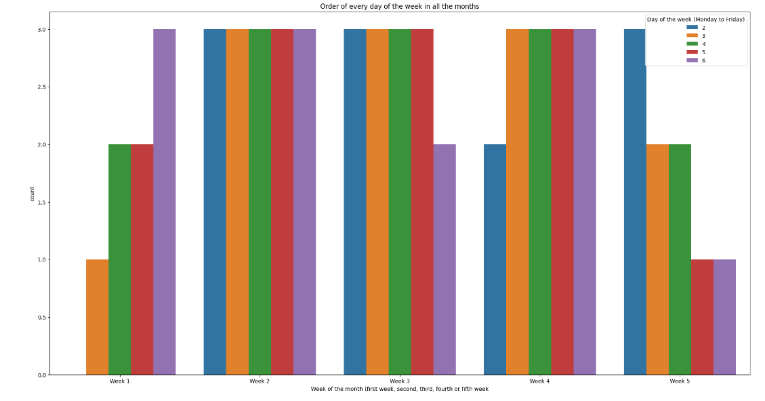
Dataset description
The Dataset was checked and understood with visualization plots as given below.
Week: 2 has the highest no. of orders compared to the other weeks
Wednesday has the highest no. of orders compared to other days of the week
Non-Urgent orders contribution is higher than urgent orders
week:2 has a higher no. of orders on all days of the week
Monday has the highest no. of Non-urgent orders in the week
Type C orders have higher distribution than other type orders

Slide 10
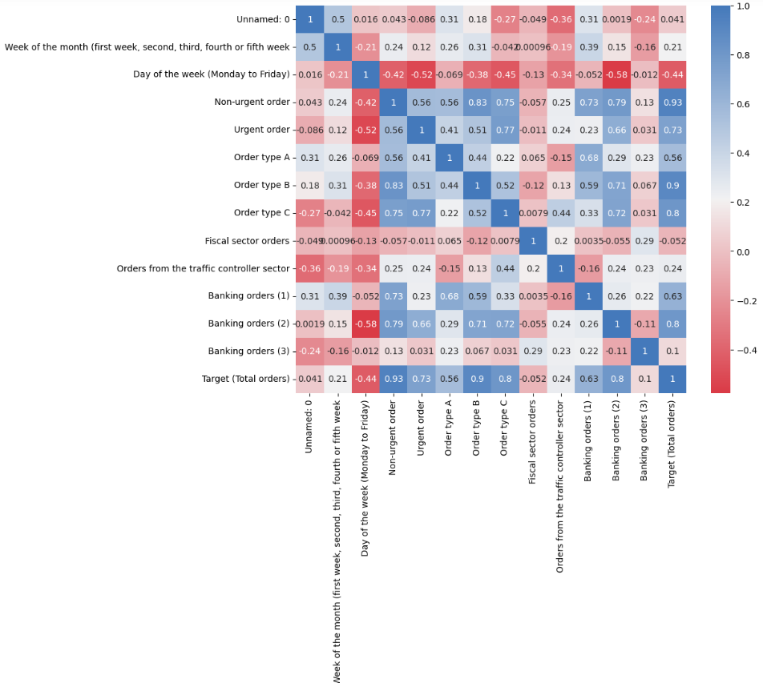
Dataset description
The heatmap to check on the correlation of the features was prepared and understood.

Slide 11
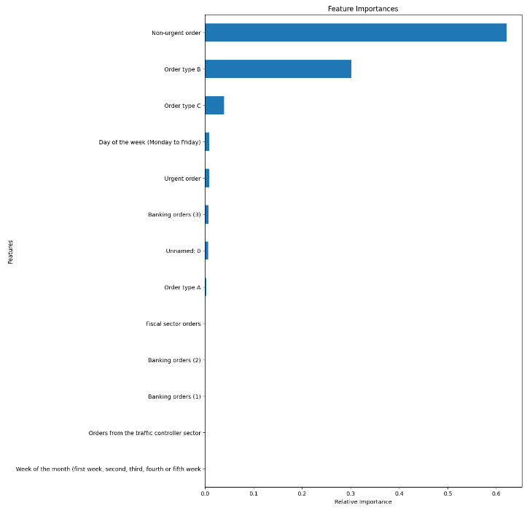
Data Preparation
The Feature Selection process was performed to understand the importance of the respective features of the dataset.
Non – Urgent Orders, Order Type B, Order Type C, Day of the Week, Urgent Orders, and Banking Orders (3) are listed as above basis Feature Importance.

Slide 12
Data Preparation
Feature columns that have little importance have been dropped and the rest were selected.
‘ Unnamed: 0', 'Week of the month (first week, second, third, fourth or fifth week', 'Banking orders 2)',’ Banking orders (1)', 'Orders from the traffic controller sector’, 'Fiscal sector orders', 'Order type A’ columns were dropped.
The list of remaining feature columns taken up for analysis are –'Day of the week (Monday to Friday)', 'Non-urgent order', 'Urgent order', 'Order type B', 'Order type C', 'Banking orders (3)', 'Target (Total orders)’
The Dataset was scaled using the standard scalar method before validation.
Train & Test datasets were split for model validation.

Slide 13
Model
Model Fitting
A Linear Regression model was first used to fit the model
The R2 score of the train set is 0.9907 and that of the test set is 0.9269
That shows the model is overfitting.
Evaluation using different Regression Models was also done to check the best model on performance.
The models used from their respective libraries were – RandomForest Regressor, Decision Tree Regressor, Catboost Regressor, KNeighbour Regressor, Gradient Boosting, XG Booster Regressor, Lasso Regressor, OMP, Linear Regression, Ridge Regression etc.

Slide 14
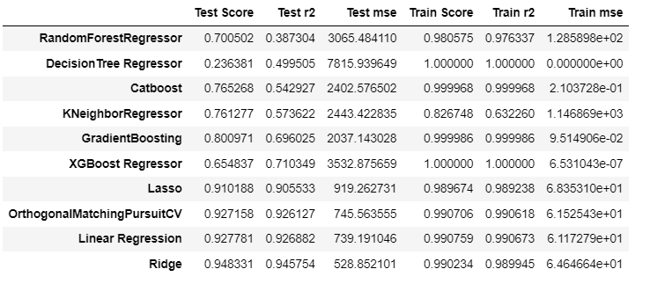
Model
Model Scoreboard
As seen above the Ridge Regression model has the R2 scores as a Train score at 0.989 and a Test score at 0.945, and the Linear Regression model with a Train score at 0.990 and Test score at 0.926 seems to be the model with the best performance.

Slide 15
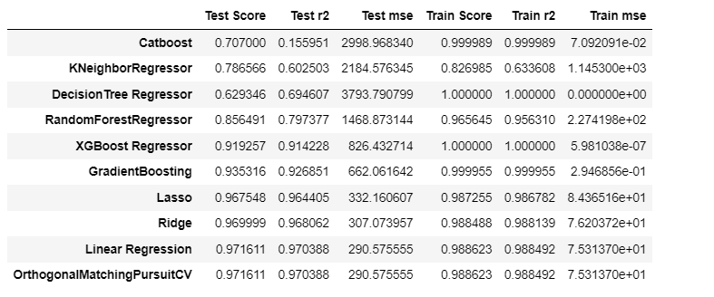
Model
Given that there is still a significant difference between training and test score, we used Principal Component Analysis to improve model performance.
Applying Principal Component Analysis (PCA) on the Model
PCA was used to reduce noise on the data and also check to see if it would help increase the accuracy of our models.
PCA was fit and transformed on the training set and transformed on the test set to avoid leakage of data.
Given below is the score board of the models after testing with PCA.
The performance score has increased as shown above.
OMP – R2 Train score at 0.988 and R2 Test score is at 0.971
Linear Regression – R2 Train score at 0.988 and R2 Test score is at 0.971
Ridge Regression - R2 Train score at 0.988 and R2 Test score is at 0.976

Slide 16
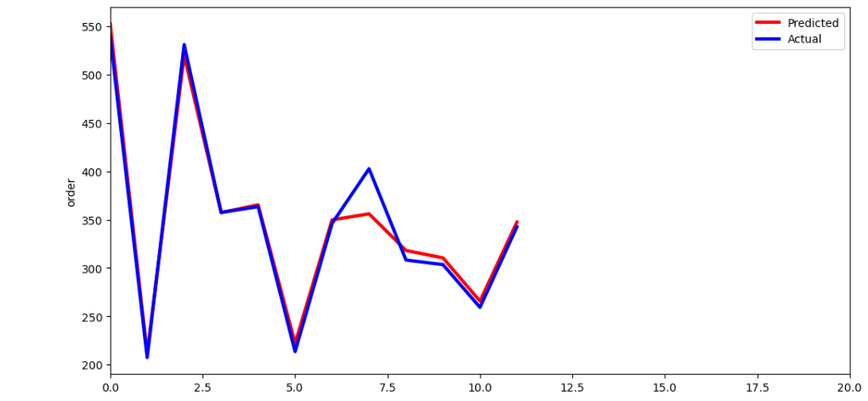
Summary
Exploratory Data Analysis was performed on the dataset to gain understanding of the different aspect of the data
Feature selection process was carried out to remove features with little or no predictive value
The dataset with the selected features, has been taken through a list of models to find the best-fit model.
The Linear Regression, Ridge Regression, and OrthogonalMatchingPursuitCV (OMP) models were the best fit models with highest R2 scores for the train and test sets compared to all other models post PCA.
The Actual and Predicted Values (from the OMP)Plotted here. The difference between them - the Residual is very minimal as shown above, confirming the models are the best fit.

Slide 17
Thank You

